Slide 1
Event Viewer and Log Monitor
Built around Microsoft’s LogParser; monitoring Windows Event Viewer, log and csv files across a server estate.

Slide 2
Overview
Built on top of Microsoft’s Logparser. Microsoft describes Logparser as a powerful, versatile tool that provides universal query access to text-based data such as log files, XML files and CSV files, as well as key data sources on the Windows operating system such as the Event Viewer, the Registry, the file system, and Active Directory.
Configurable, scheduled monitors based on Logparser queries, removing the overhead of creating Autosys jobs.
Monitors can be scheduled to run every X seconds, alerting via email if required.
Configuration achieved via password protected web interface, hosted by the service.
Results stored in database, viewable via the services web interface.
Different types of databases possible via minimal config changes (SQLite, MS SQL or Oracle).

Slide 3
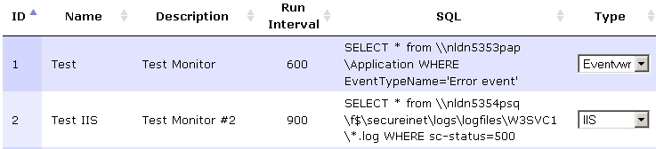
Example monitor configuration
The URL, http://localhost:8014/Monitor, would display the monitors as below:
The above shows the basic configuration for a monitor, the Name, Description, Run Interval (in seconds), SQL and Type are editable. More information on Log Parser SQL is available here: TODO

Slide 4
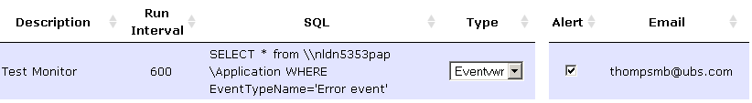
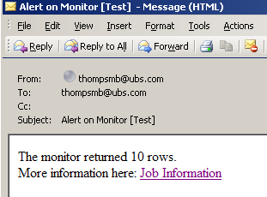
Alerting
Monitors are be configured to send details of the job via an email alert. An alert state is defined by a monitor returning data.
An email will be sent as below, clicking the link will show the results returned:

Slide 5
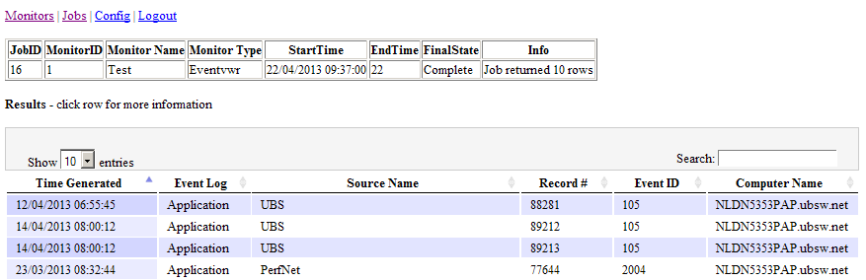
Viewing job data
The job data is viewable directly via the link in the email or be selecting the run ID via the Jobs link on the web interface. The top contains information about the job and the results in a table below.

Slide 6
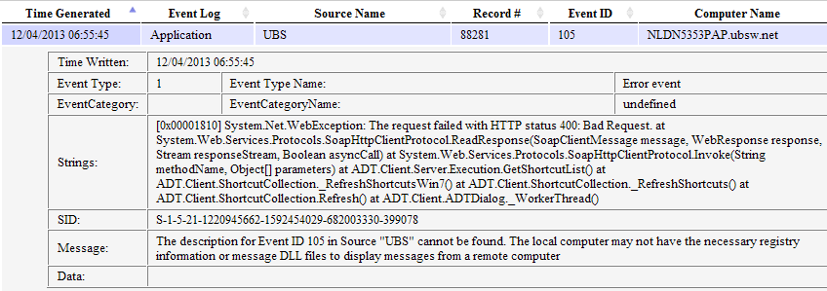
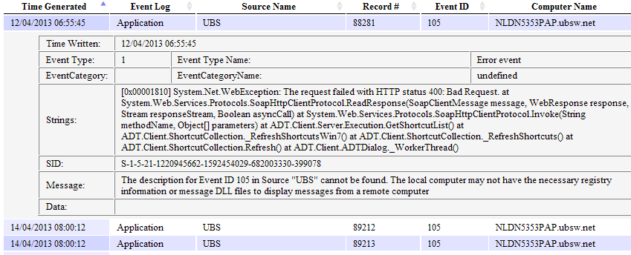
Viewing job data (continued)
Selecting a row from the bottom table expands the row to show all data associated to the entry in the Event Viewer or Log file. This example is of an Event Viewer entry.

Slide 7
Source Control and required packages
The solution is located in GitHub: URL to be added
The service uses the following packages:
  Microsoft Logparser (http://technet.microsoft.com/en-us/scriptcenter/dd919274.aspx). Microsoft describes Logparser as a powerful, versatile tool that provides universal query access to text-based data such as log files, XML files and CSV files, as well as key data sources on the Windows operating system such as the Event Viewer, the Registry, the file system, and Active Directory.
  TopShelf (http://topshelf-project.com/). Enables quick implementations of Windows Services.
  Log4net (http://logging.apache.org/log4net/). Powerful, configurable logging.
  PetaPoco (http://www.toptensoftware.com/petapoco/). PetaPoco is a tiny, fast, single-file micro-ORM for .NET and Mono.
  Nancy Web Framework (http://nancyfx.org/). A lightweight framework, enables hosting of C# based web applications.

Slide 8
Further Work
Implement groups for monitors and users.
Implement the use of Logparser batch interface, enabling SELECT * INTO queries. These would produce CSV, Charts etc.. Enabling reporting as well as alerting.
Implement more Logparser input formats (including CSV, TSV and TEXTLINE).
Implement custom SELECT statements (currently only SELECT * supported).
Bug fixing and UI improvements.

